Slide 1

Multidimensional Scaling (MDS): Competitive Market Structure and Positioning

Slide 2
Example 1
Counting the number of 4s in the following Text:
532489242209078347134097544782331028

Slide 3
In previous class (Brand Ratings Data)
We learned how to reduce dimensions using factor analysis

Slide 4
Average Brand Ratings of multiple attributes across 9 brands
Now we have a similar type of brand ratings data below… How to compare the 9 brands (B1 to B8 and New Brand) using the data table? Well… Can we have any visualization for this comparison?
B1 B2 B3 B3 B4 B5 B6 B7 B8 New
Attractive 5.1 3.6 3.5 5.4 3.9 4.8 5.2 4.0 5.2 4.0 Light 6.0 3.5 5.0 3.9 3.3 5.3 5.0 2.5 5.5 2.5 Unreliable 3.4 4.1 4.5 2.1 4.5 2.7 4.5 3.7 2.5 3.8 Plain 1.5 4.1 2.9 2.3 4.5 2.7 3.5 4.3 2.2 5.2 Battery life 3.3 4.9 4.3 4.1 3.9 3.0 3.5 6.2 3.5 4.0 Screen 3.5 5.3 3.4 6.4 5.4 5.2 3.3 6.0 3.3 4.8 Keyboard 2.6 3.5 2.5 3.4 3.8 3.3 2.8 5.0 4.3 4.7 Roomy 5.5 4.3 5.4 3.1 3.4 3.3 4.7 3.5 4.3 4.2 Easy service 4.5 4.9 3.3 5.0 4.4 4.5 3.3 4.7 3.8 4.5 Expandability 5.5 4.3 5.4 3.1 3.4 3.3 4.7 3.5 4.3 4.2 Setup 5.6 3.5 5.6 5.4 2.5 4.2 5.2 3.3 5.8 2.5 Common 4.1 3.5 3.3 2.9 4.0 4.3 2.2 4.2 3.3 4.2 Value 3.5 4.8 4.4 3.6 3.6 2.7 3.2 4.7 3.5 4.0 Preference 7.4 3.4 4.8 6.6 4.4 7.4 7.1 3.8 6.9 3.3

Slide 5
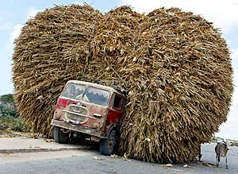
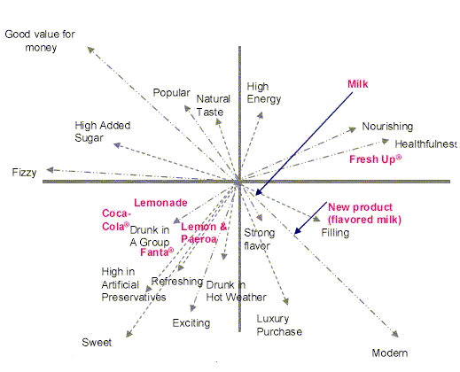
Mapping: Useful solution to the data clutter
solution
Raw Table Data format
Perceptual Map
Let’s learn how to build the perceptual brand positioning map!

Slide 6
A starting question for Principal Component Analysis (PCA)
Exam Scores of students… how many dimensions?
 | math | Science | English | Music
Joe | 80 | 85 | 60 | 55
Mike | 90 | 85 | 70 | 45
Josh | 95 | 90 | 50 | 50
Kate | 85 | 80 | 45 | 80
Ashley | 95 | 75 | 65 | 75
Beth | 100 | 90 | 80 | 60
Here, you can plot two subjects (dimensions) in 2D graph.
Can you plot three subjects (dimensions) in a graph?
Now, can you plot four subjects (dimensions) in a graph?
We can apply MDS; PCA can be used for MDS:
Note: There are multiple MDS methods but we will cover classic approaches.
Notes:
Relative computation of each attributes referenced by PC1 and PC2.

Slide 7
Principal Component Analysis (PCA)
A mathematical procedure that uses an orthogonal transformation to convert a set of data (possibly correlated variables) in to a set of linearly uncorrelated variables (PCs)
Objective: PCA reduces larger number of variables to a smaller number of dimensions (dimension reduction or data compression). So, there is no guarantee that the dimensions are interpretable.
Unsupervised learning method: It looks into the greatest sources of variation of data.
Notes:
Normalization is common for PCA: the original predictors may have different scales. For example: Imagine a data set with variables’ measuring units as gallons, kilometers.

Slide 8
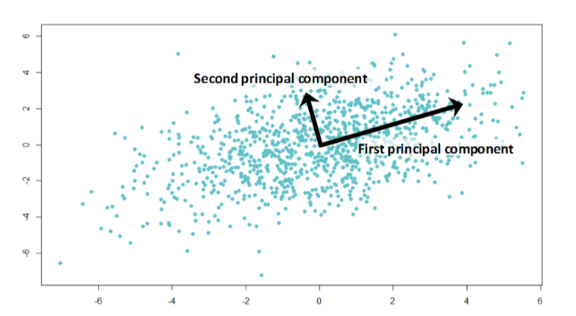
Principal Component Analysis (PCA)
PCA is to form linear combinations of the original predictors such that
the first component accounts for the largest variance in the data; the second component accounts for the second largest variance in the data.
Can be done by matrix decomposition of a data covariance (correlation) matrix.
The eigenvectors of the covariance matrix (corresponding to eigenvalues)
https://www.analyticsvidhya.com/blog/2016/03/practical-guide-principal-component-analysis-python/
Notes:
Eigen value decomposition or singular value decomposition.

Slide 9
Let’s try PCA in R
Brand Ratings Data in R (Textbook data)
The data reflects consumer ratings of brands with regard to perceptual attributes in survey
On a scale from 1 to 10 – where 1 is least and 10 is most – how [attribute] is [Brand]?
E.g., How trendy is coffee brand “a”?
Attribute Variables:
perform; leader; latest; fun; serious; bargain; value; trendy; rebuy.

Slide 10
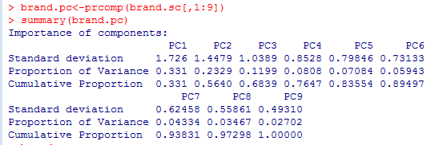
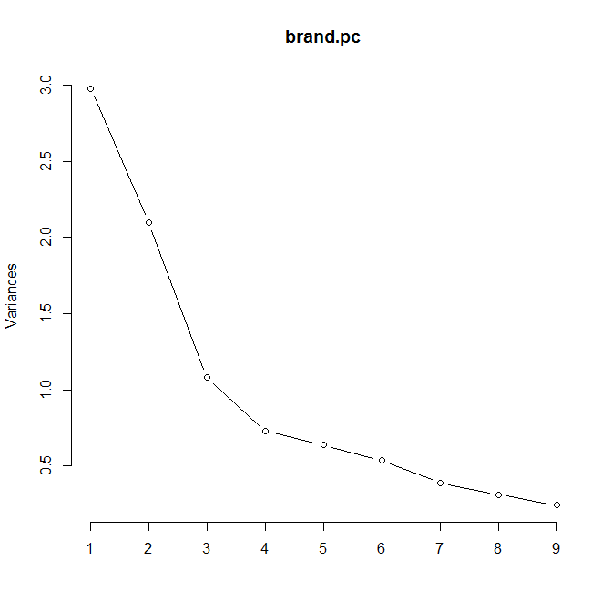
How many PCs?
Eigen values = (Standard deviation)²
Kink Point of Scree Plot
(Model User decide it)
Let’s see perceptual map
application soon…
Notes:
Eigen Values >1 一般作为筛选的标准

Slide 11
Why Brand Perceptual Map? -- Brand Competition

Slide 12
Competition in marketing literature:
I. Who are our main Competitors?
II. What are their Strategies and Objectives?
III. What are their Strengths and Weaknesses?
IV. What are their Reaction Patterns?

Slide 13
Identification of Competitors
Philip Kotler’s Four Levels of Competition:
How to determine a boundary of competition? What is total market boundary of our product?
A. Brand Competition - other companies offering the same
products and services at similar prices (e.g., Coke
has Pepsi, RC Cola, Shasta Cola,…..)
B. Industry Competition - other companies making the same product or service (e.g., 7-UP, Dr. Pepper, Slice...)

Slide 14
C. Form Competition - other companies manufacturing products that provide the same service/function
(e.g., Gatorade, Milk, Evian Water, Beer,……)
D. Generic Competition - all other companies that compete for the same consumer dollars (e.g., food products, restaurants, entertainment,….)
Here, we are focusing on: INDUSTRY COMPETITION
“A Group of Firms that offer a product or class of products that are close substitutes for each other (i.e., have high cross elasticity of demand).”

Slide 15

Assessing Competition
A Firm should assess its Competitors with respect to
objective attributes, as well as subjective perceptions
from the voice/minds of consumers.
Should also monitor below for competitions:
Share of Market (objective): Competitor’s market share – Sales Data
Share of Mind (subjective): “Name the first company that
comes to mind in this industry”.
Application Example: https://hbr.org/2015/06/a-better-way-to-map-brand-strategy

Slide 16
Share of Mind (subjective) - “Name the company from whom you would prefer to buy the product”.
Typical data sets: Competitor x Attribute Matrix
Customer’s Ratings of Competitors on Key Success Factors
Customer Awareness
Product Quality
Product Availability
Technical Assistance
Selling Staff
Competitor A E E P P G
Competitor B G G E G E
Competitor C F P G F F
Note: E = excellent, G = good, F = Fair, P = poor.
→ Customers’ comparative ratings in attributes across competitors…

Slide 17
Why Brand Perceptual Map? Positioning and Differentiation Strategy in Marketing

Slide 18
Brand Perceptual Maps
It informs competition structure amongst Brands
A perceptual map is a visual representation of how target customers view the competing alternatives in a Euclidean space (Brand Perceptual Map example used by Steve Jobs…)
The map has the following characteristics:
The pair-wise distances between product alternatives directly indicate how close or far apart the products are in the minds of customers
The axes of the map are a special set of vectors suggesting the underlying dimensions (e.g., Principal Component1 or 2) that best characterize how customers differentiate between alternatives

Slide 19
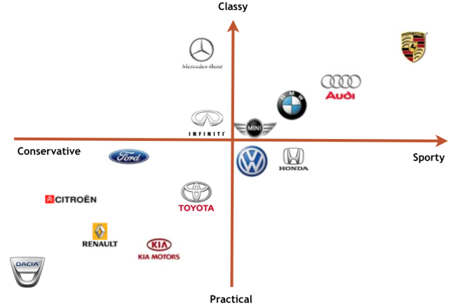
Example of Perceptual Map (Auto Brands)
https://rockstarsbm.wordpress.com/2014/11/23/perceptual-maps/
From this perceptual map: 1. we can see how each car brand is comparatively positioned in peoples’ mind.
2. This is helpful for developing marketing strategy for differentiating from other competing car brands.

Slide 20
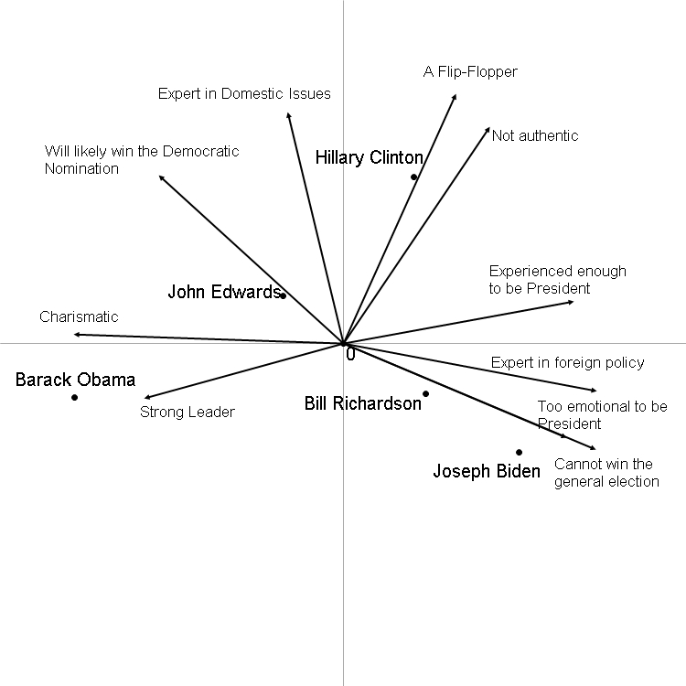
Perceptual map of Democratic Candidates for United States President (2008)
Map displays “brands” and attributes

Slide 21


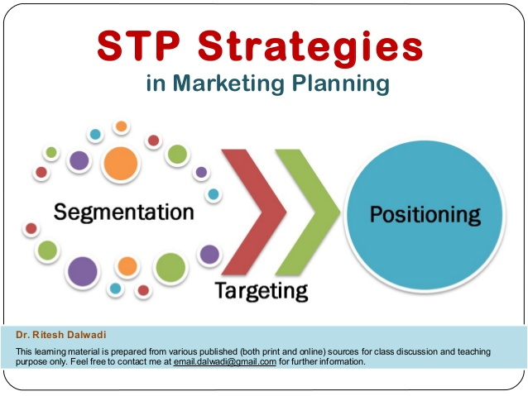
Differentiation and Positioning in Marketing
Differentiation: “The creation of tangible or intangible differences on one or two key dimensions between a focal product and its main competitors”
How does Targe differentiate from Walmart ?
How do Southwest Airline differentiate from other competing airlines?
Positioning: “The set of strategies that firms develop and implement to ensure that the differences occupy a distinct and important position in the minds of consumers” : (Think about STP Strategies in Marketing).

Slide 22
More about Positioning Strategy
Some attribute-based differentiators
Main Functions (what it does)
Features (how it does it) – Adding new features can differentiate
Performance (how well it does it) -- e.g., BMW in auto market?
Reliability (consistency of performance)
Durability (product life)
Serviceability (ease of maintenance)
Design (aesthetics, ergonomics, etc.)
Common surrogate based differentiators
Image
Reputation

Slide 23
Perceptual map in R
Let’s use PCA method to build perceptual map in R – Several functions but let’s use ‘prcomp’ (base one)
Let’s try MDS (‘cmdscale: classical multidimensional scaling’ based on distance-based dissimilarity).
‘cmdscale’ provides points per brands: rows give the coordinates of the points chosen to represent dissimilarities.
I would try other R packages (FactoMineR)

Slide 24
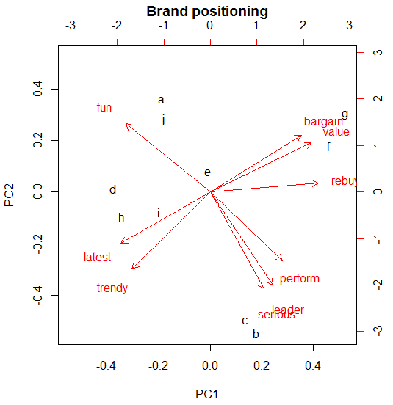
See brand positioning map by PCA (Brand mean data has been projected to two dimensions [PCs])
Location coordinates for each brands
Directions for each attribute vector
Notes:
For PC 1 and PC2, the PCA analysis doesn’t provide possible label (items) information.

Slide 25
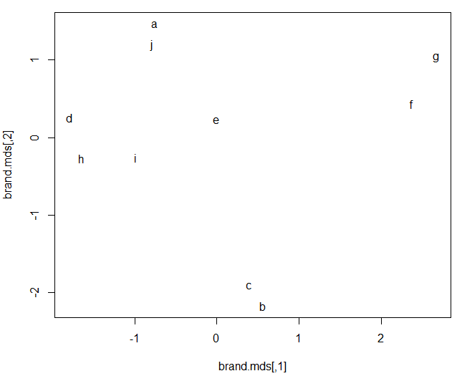
See brand positioning map by ‘cmdscale’ in R

Slide 26
Managerial Questions with Brand Ratings Data
Which brands are competition relationships in the market?
Brand ‘g’ and ‘f’ are strongly positioned in which attribute(s)?
Which features are correlated?
Are the two maps by ‘PCA’ and ‘cmdscale’ are similar (note, don’t consider vector lines in ‘cmdscale’)?

Slide 27
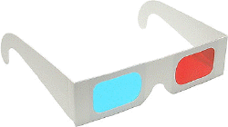
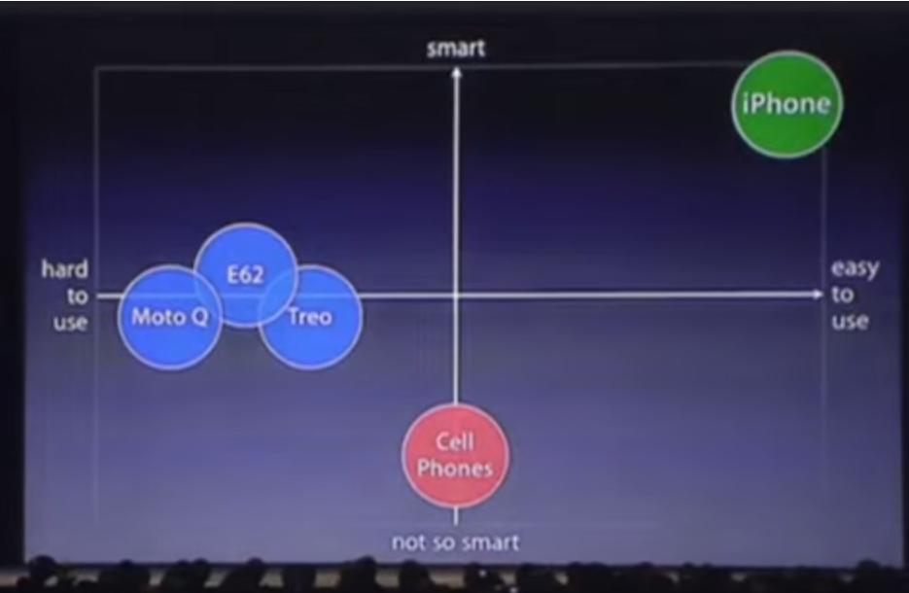
A good positioning strategy requires …
An understanding of the dimensions along which the consumer perceives the product
Knowing how competitors’ products are perceived along these dimensions
Identifying the brand position compared with other competitors
Considering a firm’s strengths and available resources, the firm can find the optimal positioning location and develop positioning strategy.

Slide 28
Tools for brand perceptual map
Multidimensional Scaling (MDS) refers to class of procedures for representing perceptions and preferences of respondents spatially (i.e., in two-dimensional map).
Note, we are interested in “Perceptual” and not necessarily Engineering attributes – focusing consumer’s perceptions..
“# of mile per gallon” vs. “Fuel Efficiency”
“Interior Space” vs. “Roominess”
Main data types:
Similarity
Attributes
Preferences
Notes:
Basic MDS is same like PCA but MDS can have more extension models as shown in the book chapter.

Slide 29
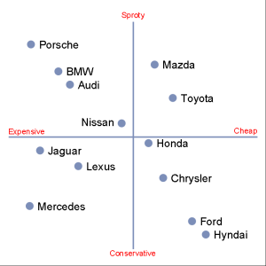
COMPETITIVE MARKET STRUCTURE
We can utilize MDS estimated on one or more of the data sets to spatially represent the competition structure in the data.
A Graphical Display illustrating the interrelationships between competitive brands/products/services.
Have a variety of different MDS models depending on which data set selected.

Slide 30
Data Types/Collection for MDS
Can collect such data from either primary or secondary sources:
1. Collect pairwise (dis)similarities of competitive brands in a designated product class from consumers.
2. Collect ratings for perceptions or beliefs of how much each brand has of specific attributes from consumers.
3. Record objective attribute information from secondary sources (e.g., package labels).
Then, construct brand maps via Multidimensional Scaling (MDS)

Slide 31
Similarity Data Example (Not Very Popular)
Please rate the following pairs of toothpaste brands on the basis of their similarity (1 = very similar, 9 = very dissimilar).
Very Very
Similar Dissimilar
1. Aqua-Fresh vs Crest 1 2 3 4 5 6 7
2. Aqua-Fresh vs Colgate 1 2 3 4 5 6 7
…
45. Pepsodent vs Dentagard 1 2 3 4 5 6 7
Notes:
Using (dis)similarity matrix, it is available only for two dimensional map. By using multiple attributes measure, still we can measure the similarity distances but we also can add multiple attributes lines (see PCA in the book p 206)

Slide 32
City-Distances (easiest example)
(Dis)similarity ≈ Distance
Geographically two dimensions and we used this for ‘cmdscale’ before
Notes:
Correlation can also describe the similarity of cities

Slide 33
Types of MDS
Classical multidimensional scaling (we will focus in this class):
Input matrix of dissimilarities (e.g., distance) between pairs of items and outputs a coordinate matrix
Metric multidimensional scaling:
A superset of classical MDS that generalizes the optimization procedure to a variety of loss functions (stress).
Non-metric multidimensional scaling:
Such as rankings or categorical variables.

Slide 34
MDS Practice in R with Infiniti Data example
Use cmdscale R package for this analysis.
Let’s try FactoMineR package as well…
Which bands groups are in competition in the market?

Slide 35
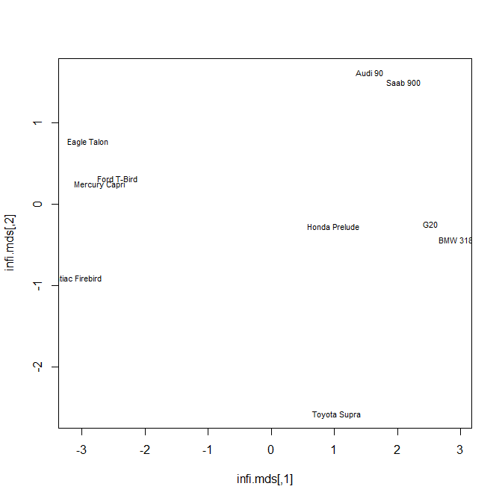
Infiniti G20 Market Analysis Case

Slide 36
Positioning Strategy Examples
Value or Price positioning
(e.g., Fast-food restaurants, Southwest airline).
Product benefits positioning
(e.g., Colgate prevents cavities).
Competitor-based positioning
(e.g., Geico).
You always position/reposition within a target market segment !!!
Notes:
3
Geico– faster, easier, cheaper and similar level of services…

Slide 37


Positioning Example (AVIS Campaign)
We are Number 2! (AVIS) – 1962
from 1963 to 1966: Market Share has changed from 61%(Hertz)-29%(Avis) to 49%(Hertz)-36%(Avis).

Slide 38
IMPLIED MARKETING STRATEGIES – MDS POSITIONING
THE CLOSER THE POSITIONING OF TWO BRANDS, THE MORE LIKELY THEY ARE TO COMPETE.
2. THE MORE ISOLATED A BRAND IS ON SOME RELEVANT DIMENSION, THE MORE UNIQUE IT IS CONSIDERED TO BE.
3. MOVE BRAND CLOSER TO ANY TARGET IDEAL POINTS (CONSIDERING STRENGTH AND RESOURCES).
4. INTRODUCE NEW PRODUCT NEAR TARGET SEGMENT’S IDEAL POINT.

Slide 39
MKT 591: Course Roadmap
Review of Quant Market Research
Prediction / Regression
Forecasting
Features & Dimensions
Market Segmentation
Simple Linear Regression
Demand Forecasting
Customer Classification
Factor Analysis
Segmentation Basic
Measurement Scales
Categorical Variables
BASS Diffusion Model
Discriminant Analysis
MDS
Advanced Model-based Segmentation
Discrete Analysis (CrossTab)
Extracting Features by Text Analytics
Multiple Regression
Bayesian Classifier
Spatial Segmentation
Continuous Analysis (Correlation)
Issues in Regression
Tree Models
Deep Learning
Logistic Regression (Consumer Choice)
Bayesian Statistics

Slide 40
Optional Appendix) Technical explanations for MDS

Slide 41
DATA COLLECTION for (dis)similarity
“HOW DO I GET ?”
Note: = is typically square and symmetric
Brand
1 2 3
• • • • • • • • • • • • • • • • • •
N
3.2 4.1 . . . . . . . . .
1 2 3
3.2
4.1
..
..
..
..
..
..
..
..
..
..
Brand
• • • • • • • • • • •
N
Must collect values for all distinct pairs of i, j. HOW?

Slide 42
A. DIRECT METHODS:
1. CATEGORY RATING
EX.:
2. GRAPHIC RATING
EX.:
CAMARO: MUSTANG
HIGHLY HIGHLY
SIMILAR DISSIMILAR
_ _ _ _ _ _ _ _ _
CAMARO: MUSTANG
0 1 2 3 4 5 6 7
HIGHLY HIGHLY
SIMILAR DISSIMILAR
MEASURE THIS DISTANCE
AS A RATING

Slide 43
B. DERIVED MEASURES
SUPPOSE YOU HAVE A BRANDS BY ATTRIBUTE MATRIX Z =
CAN COMPUTE dissimilarity/distance by:
AND USE AS INPUT
NOTE: MAKE SURE ARE COMPARABLY SCALED (MAY WANT TO
INITIALLY COLUMN STANDARDIZE Z)
~
Attributes
Brands

Slide 44
Basic Concepts of MDS Notation:
i, j = 1…….N brands
t = 1…….T dimensions
= data input - the dissimilarity between brands i and j
= the distance between brands i and j in the MDS space
= the t-th coordinate for brand I in the derived T-dimen-
sional space/map
We are searching coordinates which minimize differences between observed (dis)similarity and estimated distances.

Slide 45
MDS METHODS/ALGORITHMS
= the data (given)
= the distances =
T = number of dimensions (specified a priori)
= the brand coordinates (solve for)
Objective:
Given and T, find such that the resulting distances
are close to the data
Mathematically:
Find to minimize:
S = Stress = “Badness of Fit”
S > .10 poor fit
.05 < S < .10 ok
S < .05 good fit
Here, iteratively estimate coordinates to reduce the Stress function

Slide 46
DIMENSIONALITY SELECTION
- RUN ANALYSIS IN t = 1, 2, 3, . . . ., T DIMENSIONS
- PLOT GOODNESS OF FIT MEASURE
- SELECT T* WHERE ‘ELBOW’ IN CURVE
1 - (R²)
or
Stress
T* = 3 here
1 2 3 4 5 6
NUMBER OF DIMENSIONS
T
Notes:
Even though there are similarities in the type of research questions to which these two procedures can be applied, MDS and factor analysis are fundamentally different methods. Factor analysis requires that the underlying data are distributed as multivariate normal, and that the relationships are linear. MDS imposes no such restrictions. As long as the rank-ordering of distances (or similarities) in the matrix is meaningful, MDS can be used. In terms of resultant differences, factor analysis tends to extract more factors (dimensions) than MDS; as a result, MDS often yields more readily, interpretable solutions. Most importantly, however, MDS can be applied to any kind of distances or similarities, while factor analysis requires us to first compute a correlation matrix. MDS can be based on subjects' direct assessment of similarities between stimuli, while factor analysis requires subjects to rate those stimuli on some list of attributes (for which the factor analysis is performed).

Slide 47
Example #2
SIMILARITY RATINGS OF TOOTHPASTE BRANDS
Aqua- Ultra
Fresh Crest Colgate Aim Gleem Macleans Bright Close-up Pepsodent Dentagard
Aqua-Fresh
Crest 5
Colgate 6 7
Aim 4 6 6
Gleem 2 3 4 5
Macleans 3 3 4 4 5
Ultra Brite 2 2 2 3 5 5
Close-Up 2 2 2 2 6 5 6
Pepsodent 2 2 2 2 6 6 7 6
Dentagard 1 2 4 2 4 3 3 4 3

Slide 48
PLOT OF STRESS VERSUS DIMENSIONALITY

Slide 49
A SPATIAL MAP OF TOOTHPASTE BRANDS
2.0
Macleans
Aim
Crest
Ultrabrite
Gleem
Pepsodent
0.0
Colgate
Close-up
Aqua-Fresh
Dentagard
-2.0
-2.0
0.0
2.0

